Slide 1
Trisomy 21
Anni 230321

Slide 2
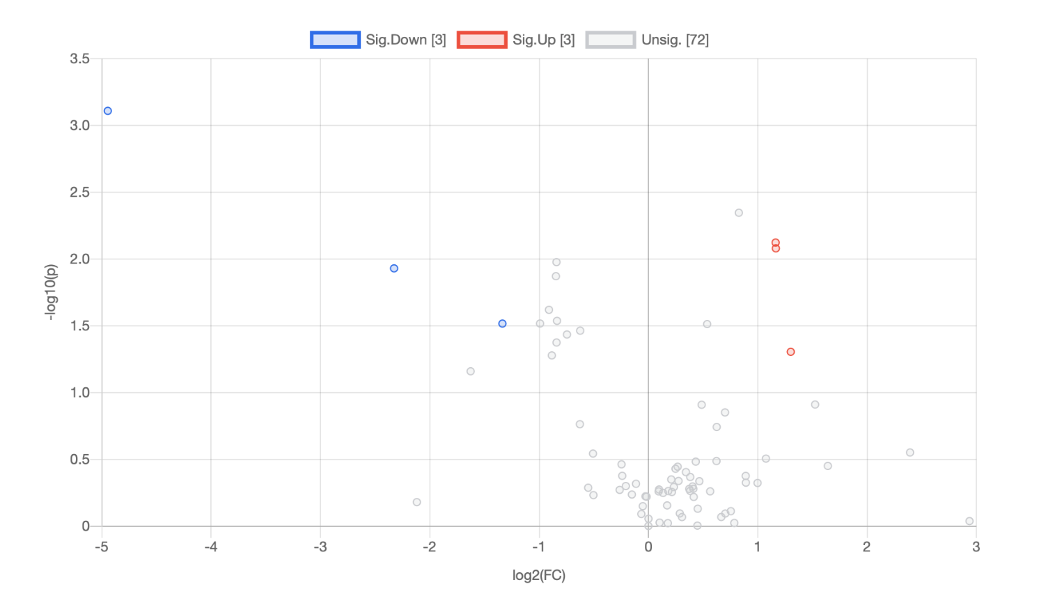
Comparison 1. control vs Trisomy 21 only flux forms

Slide 3
Heatmap – t-test
Nucleotide synthesis
NAD synthesis
Glycolysis
Glycerol 3-phosphate pathway

Slide 4
t-test raw p-value <0.05
 | t.stat | p.value | -log10(p) | FDR
Dihydroxyacetone Phosphate (DHAP)+3 | -4.2699 | 0.00077751 | 3.1093 | 0.060646
ADP +5 | 3.3781 | 0.0045045 | 2.3464 | 0.14987
NAD +5 | 3.1199 | 0.0075295 | 2.1232 | 0.14987
AMP +5 | 3.0695 | 0.0083219 | 2.0798 | 0.14987
2-Phosphoglycerate+3 | -2.9501 | 0.010544 | 1.977 | 0.14987
PEP+3 | -2.8954 | 0.011748 | 1.93 | 0.14987
3PG+3 | -2.8269 | 0.01345 | 1.8713 | 0.14987
Succinic acid+2 | -2.5305 | 0.024008 | 1.6196 | 0.19957
SAH+3 | -2.432 | 0.029034 | 1.5371 | 0.19957
Glycerol 2-phosphate+3 | -2.408 | 0.030401 | 1.5171 | 0.19957
Glycerol 3-phosphate+3 | -2.4074 | 0.030436 | 1.5166 | 0.19957
citrate/isocitrate +2 | 2.4028 | 0.030704 | 1.5128 | 0.19957
Succinic acid+3 | -2.3433 | 0.034401 | 1.4634 | 0.20469
erythrose 4-phosphate+3 | -2.3087 | 0.036739 | 1.4349 | 0.20469
ATP +5 | -2.2354 | 0.042196 | 1.3747 | 0.21942
GMP+5 | 2.1501 | 0.049511 | 1.3053 | 0.24137
Nucleotide synthesis
NAD synthesis
Glycolysis
Glycerol 3-phosphate pathway

Slide 5
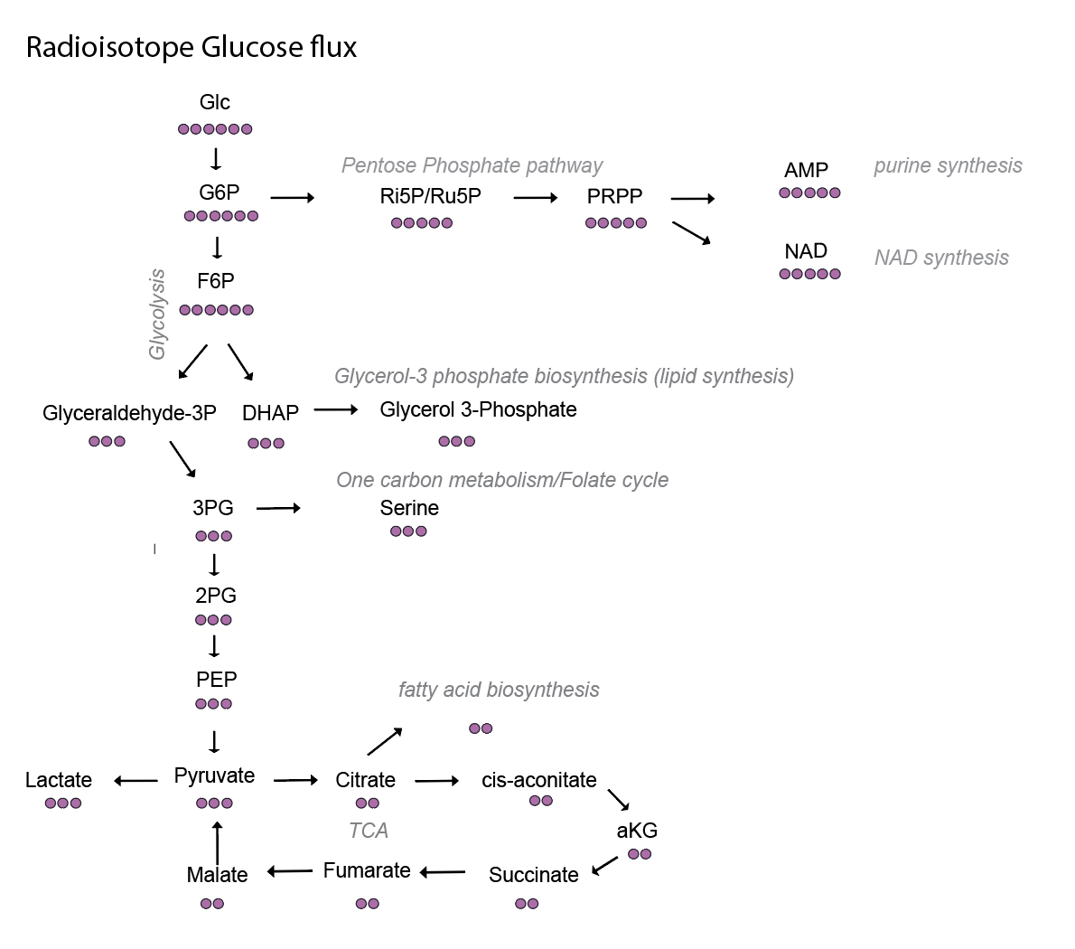
Glycolysis increased in Trisomy
Would be good if you make graphs for all of these in excell

Slide 6
PPP shunt: Nucleotides_NAD decreased in Trisomy
?
Could be that m+0
values are different
What is AMP:ATP ratio? And NADH:NAD?

Slide 7
TCA: ? Need to see this more carefully
Too low levels

Slide 8
Glycerol 3-phosphate synthesis increased in Trisomy (Triglycerides?)

Slide 9
Steady state levels? M+0 values from data

